Slide 1

The Ethics and Economics of Environmental Protection
6. Policy tools for environmental protection

Slide 2


1. The policy problem
Deontology: freedom in philosophy
?
The risk of catastrophic harm
What do we owe one another?
Utilitarianism: well-being in the world
Pure hedonism (untenable)
1. SOCIAL SCIENCE PRINCIPLES
How is well-being generated?
2. SOCIAL SCIENCE MECHANISMS
How can we realise well-being in the world?
Policy direction
(Top-down prices)
Decentralised (market) discovery
(Bottom-up prices)

Slide 3
A note on terms: values and mechanisms
VALUES (ENDS)
The fundamental (utilitarian) principle in economics is that we must make trade-offs when allocating time, effort, and resources
The question is how to ensure that our trade-offs are efficient relative to the values we want to maximise (e.g., human well-being)
Protection is warranted when the benefits from conserving environmental goods exceed the value of the benefits that would be produced by consuming those goods
Protection is optimal when the costs of environmental damage are efficiently recognised by beneficiaries, so that each decision maximises benefits over costs
MECHANISMS (MEANS)
The fundamental problem in economics is how to structure social interactions to ensure efficient trade-offs
This is a question of mechanisms: what real-world processes will turn the benefits we can identify in principle into outcomes?
A mechanism is present (dominant) if it contributes to (determines) the reasons people have for their decisions
A mechanism is efficient if it leads people to act in such a way that they realise its intended benefits without negative unintended consequences

Slide 4
From principles to policies
Well-being as market efficiency (sheepism)
Imperfect prices prevent the full value of environmental goods from being properly registered by private decisionmakers
Left to themselves, markets will generate pervasive failures (inefficiencies)
Intervention is necessary to ensure decisionmakers account for these values
Intervention works by changing (correcting) the prices facing agents
Command and control uses (the threat of) coercion to force efficient behaviour
Price-based interventions encourage efficient behaviour by imposing correct prices from the centre
Well-being as market discovery (wolvism)
Incomplete prices prevent the full value of environmental goods from being properly identified by any decisionmaker
Intervention only imposes policymakers’ value estimates on the rest of the population
Competition is necessary to test, and sift, our various estimates, and to discover the best ones
Competition works by decentralising decisions, so that individuals may respond to contextual details
Private property allows individuals to enter and exit social arrangements according to their net benefits
Political decentralisation allows institutional entrepreneurs to try innovative governance regimes

Slide 5

2. Mechanisms of intervention
Remember: Centralised policies are required to force individuals to bear the full (efficient) costs of their actions
Methods for judging value
Hedonic pricing: examining market behaviour for evidence of “willingness to pay”
Travel-cost method: interpreting the costs people pay to access environmental resources as “shadow prices”
Contingent valuation: asking people how much they would pay to protect/obtain a good
Mechanisms for imposing value
Regulations, directives, fines (E.g., the Environmental Protection Act; Bans on dangerous fertilisers; planning acts; climate change targets)
Market manipulation (E.g., green taxes and subsidies, green investment banks, The “Green New Deal”)

Slide 6
How efficient are the mechanisms of intervention?
Theoretical strengths
Price-based interventions
Flexibility appeals to economists
Comparatively epistemically undemanding
Comparatively cheap to enforce
Command and control
Inflexibility appeals to voters (e.g., XR)
Comparatively institutionally undemanding
Comparatively durable
Practical problems
Price-based interventions
Flexibility is irrelevant if economists’ value estimations are inaccurate
If target individuals are ignorant of environmental values, price-based int. will have random effects
Command and control
We cannot assume voters know environmental values without interrogating their mechanisms
Incentives in political institutions do not necessarily promote the public good (as opposed to political agents’ own goals)

Slide 7
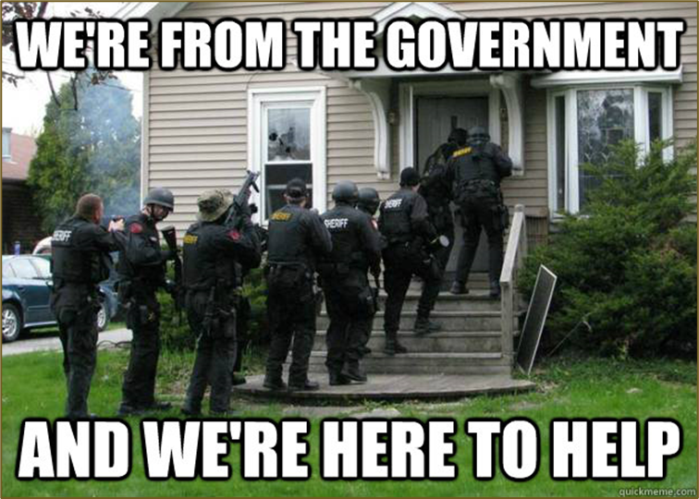
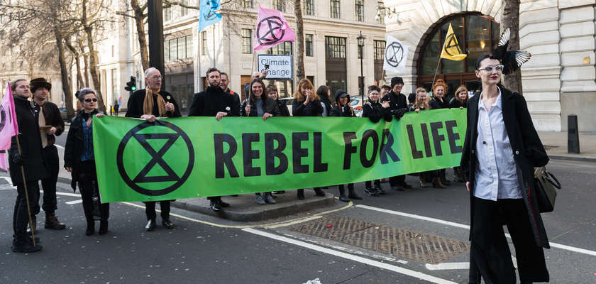
Varieties of government failure
Recall that interventionism will succeed if its mechanisms to internalise environmental externalities are:
Present (i.e., politicians and/or voters do not choose other goals entirely)
Efficient (i.e., economists are able to extrapolate true values from subsamples of the population)
Do we have reason to doubt this?
Politicians certainly have the opportunity to pursue their own interests over those of voters, and rent-seeking is not trivial
But (more significantly) subsample values provide a valid picture of the whole population only if the population is homogeneous
Individuals must trade-off values in identical ways
Individuals must respond to policies in identical ways
or
Is this plausible?

Slide 8

3. Privatisation and discovery
The argument for privatisation was formalised in Ronald Coase’s 1960 essay “The Problem of Social Cost”
Private property is a useful institutional evolution which helps us to mitigate the costs of exchange (“transactions costs”, or TCs)
Coase asks us, for instance, to imagine a situation where a farmer faces the risk of fire from railway sparks
Absent TCs, all exchanges would be perfectly efficient; but in the real-world, we are fundamentally dependent on institutions like property to ↓ TCs
More generally, Coasian property rights are supposed to turn zero-sum political games into positive sum economic ones by facilitating efficient trade-offs
Bargains over cross-cutting externalities are equivalent to bidding for the right to affect other people’s interests in the pursuit of your own
The more such bargains, the closer we get to Pareto optimality (the so-called Coase theorem)

Slide 9

Markets: what’s the beef?
The best argument for extending private property is that it promotes competitive experimentation
All policies are, in effect, experiments, but learning from them is difficult because of the absence of comparative evidence
Private experiments, in contrast, allow numerous simultaneous “tests” of policy theories—and they generate price signals that might convey the value realised by these theories
Plenty of environmental resources can be fenced and privatised at low cost (e.g., forests, parks, rivers, inshore fisheries, many wildlife populations)
Where fencing is not possible, communities may compete over the rules by which resources are used and shared (e.g., the rules of access to off-shore fisheries or large aquifers; or at the next level up the rules of exchange between communities)
Do the most common arguments against privatisation miss the point?
Privatisation would need the state to support it
The distributional consequences would be intolerable
Privatisation would lead to a destructive concentration of private power

Slide 10
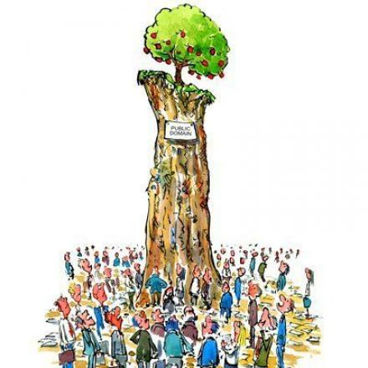
The mechanism question
Is privatisation (of either individual or collective goods) efficient?
The central assumption of all neoliberal arguments is that individuals in their private capacity disagree about what trade-offs are optimal: environmental values are not obvious
But if this is true then neoliberals fall into contradiction when they assume that competition will discover who is right
If prices conveyed objective, unambiguous truths, there would be no disagreement, and no need for competition
If the total effects of an institution could be directly inferred from individual experiences, there would be no need for Ostromian decentralisation
If wolvism is an issue, it is because it ensures that no viewpoint or experience can stand for the whole; but then how are entrepreneurs any better placed to identify values than policymakers?

Slide 11

4. Summary: Wolves and sheep, redux
Does N tend to, or away from, 1?
N = 1
People are misguided sheep
People are unpredictable wolves
What’s the policy problem?
Issue: People are reliably irrational (they harm their collective interests in reliably ways)
Mechanism: Policy will change incentives so that people maximise social values
Worry: This argument is nothing more than an (implausible) assumption: who among us fits its anthropology
Issue: People’s situations are heterogeneous, so they judge values heterogeneously, and therefore unpredictably
Mechanism: Competition will create opportunities for people to adapt governance arrangements to local circumstances
Worry: Neoliberal arguments assume that all relevant consequences will be direct and knowable, which is inconsistent with their beginning assumption

